Slide 1


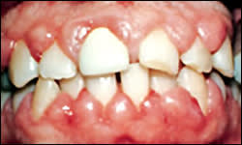
GINGIVAL ENLARGEMENT
RUNGTA COLLEGE OF DENTAL SCIENCES AND RESEARCH,BHILAI
Dr PUSHPENDRA YADAV
Senior Lecturer
Dept of Periodontology

Slide 2
SPECIFIC LEARNING OBJECTIVES
CORE AREAS | DOMAIN | CATEGORY
INTRODUCTION | Affective | Desire to know
CLASSIFICATION | Cognitive | Must to know
INFLAMMATARY ENLARGEMENT | Cognitive | Must to know
DRUG INDUCED ENLARGEMENT | Cognitive | Must to know
IDIOPATHIC ENLARGEMENT | Cognitive | Must to know
ENLARGEMENTS ASSOCIATED WITH SYSTEMIC DISEASES | Cognitive | Must to know
NEOPLASTIC ENLARGEMENT | Cognitive | Must to know
FALSE ENLARGEMENT | Cognitive | Must to know

Slide 3

CONTENT
PART-I
Introduction
Classification
Inflammatory enlargement
    Chronic
    Acute
    PART--II
Drug-induced enlargement
    Anti-Convulsants
    Immunosuppresants
    Calcium Channel Blockers

Slide 4
Idiopathic Gingival enlargement
PART-III
Enlargements associated with systemic diseases or conditions
Neoplastic enlargements
False enlargement
Summary
Reference

Slide 5
ANTICONVULSANTS
(PHENYTOIN)

Slide 6
The first drug induced gingival enlargements reported were those produced by phenytoin (Dilantin).
Dilantin is a hydantoin introduced by Merritt and Putnam in 1938 for the treatment of all forms of epilepsy except petit mal
Other hydantoins known to induce gingival enlargements are
  - Ethotoin
  - Mephenytoin

Slide 7
Other anticonvulsants that have the same side effect are the
  - Succinimides
  - Methsuxinimide
  Valproic acid
  Carbamazepine
Gingival enlargement occurs in about 50% of patients receiving the drug although some authors have reported incidences from 3% to 84.5%.
It occurs more often in younger patients

Slide 8
The pathogenesis of gingival enlargement induced by phenytoin is not known, but some evidence links it to
  a direct effect on specific, genetically predetermined subpopulations of fibroblasts,
  inactivation of collagenase, and
  plaque-induced inflammation

Slide 9
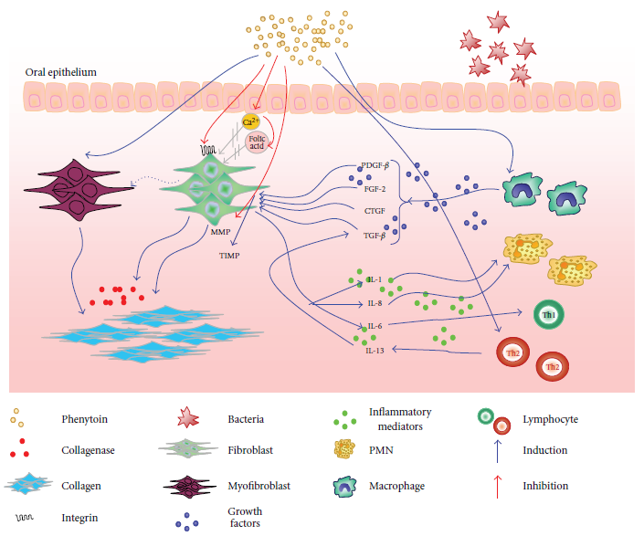

Slide 10
IMMUNOSUPPRESSANT (CYCLOSPORIN)

Slide 11
Cyclosporine is a potent immunosuppressive agent used to prevent organ transplant rejection and to treat several diseases of autoimmune origin.
Its exact mechanism of action is not well known but it appears to selectively and reversibly inhibit helper T cells which play a role in cellular and humoral immune responses.
Cyclosporine A, (Sandimmuneis, Neoral) administered intravenously or by mouth and dosages greater than 500 mg/day have been reported to induce gingival overgrowth.

Slide 12
Growth starts in the papillae – anterior facial areas & tissue is pink, dense, reselient and little bleeding tendency
Cyclosporine induced gingival enlargement is more vascularized than the phenytoin enlargement
Occurs in
  approximately 30% of patients receiving the drug
  more frequent in children and
  its magnitude appears to be related more to the plasma concentration than to patients periodontal status.

Slide 13
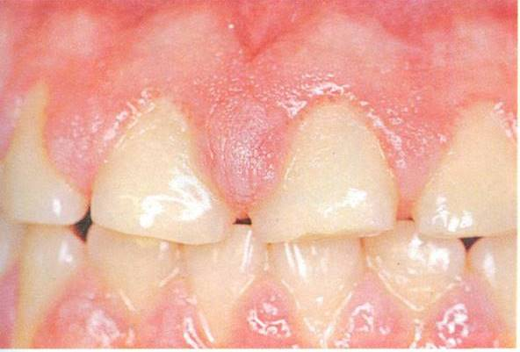
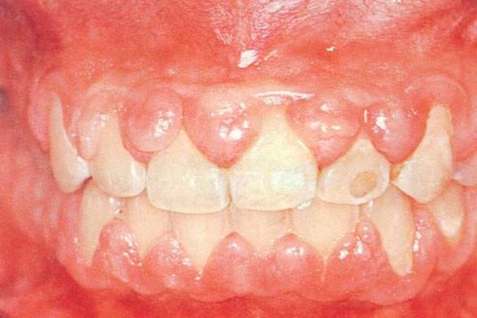

Slide 14
CALCIUM CHANNEL BLOCKERS

Slide 15
Developed for the treatment of cardiovascular conditions such as hypertension, angina pectoris, coronary artery spasms and cardiac arrythmias.
They inhibit calcium ion influx across the cell membrane of heart and smooth muscle cells, blocking intracellular mobilization of calcium.
This induces direct dilation of the coronary arteries and arterioles improving oxygen supply to the heart muscle it also reduces hypertension by dilating the peripheral vasculature.

Slide 16
Nifedipine….most common…..20% of the cases
Other drugs…..Diltiazem, felodipine, nicardipine and verapamil
The first case of nifedipine induced gingival overgrowth was reported in 1984.
The exact mechanism ……still under investigation however several possible hypothesis have been proposed.

Slide 17
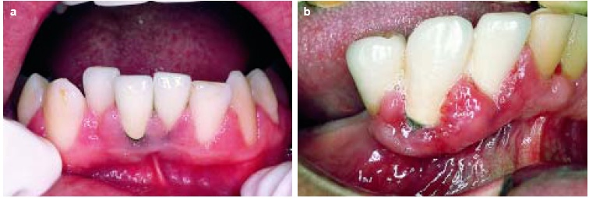

Slide 18
IDIOPATHIC GINGIVAL ENLARGEMENT

Slide 19
a rare oral condition of undetermined cause
Synonym: - Elephantiasis gingiva
        - Hereditary gingival hyperplasia
        - Idiopathic fibromatosis
        - Congenital familial fibromatosis

Slide 20
Etiology:
Unknown
some have a hereditary basis
May be autosomal recessive or autosomal dominant
May be linked to impairment of physical development

Slide 21
The enlargement usually begins with the eruption of the primary or secondary dentition and may regress after extraction suggesting the possibility that the teeth or the plaque attached to them may be initiating factors
Gingival enlargement occurs in tuberous sclerosis

Slide 22
Clinical features:
The enlarged gingiva is pink, firm and almost leathery in consistency and has a characteristic minutely pebbled surface
In severe cases the teeth are almost completely covered and the enlargement projects into the oral vestibule
The jaws appeared distorted because of the bulbous enlargement of the gingiva

Slide 23
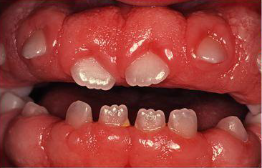
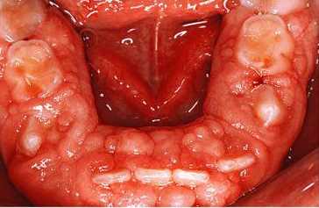

Slide 24
ENLARGEMENT ASSOCIATED WITH SYSTEMIC DISEASES OR CONDITIONS

Slide 25
Systemic diseases or conditions can effect the periodontium by two different mechanisms
Magnification of an existing inflammation initiated by dental plaque
Manifestation of the systemic diseases independently of the inflammatory status of the gingiva

Slide 26
Conditioned Enlargements
    Pregnancy
    Puberty
    Vitamin C deficiency
    Plasma cell gingivitis
    Non-specific conditioned enlargement (pyogenic granuloma)
Systemic Diseases causing Gingival Enlargement:
    Leukemia
    Granulomatous diseases (Wegener’s granulamatosis, sarcoidosis, etc.)

Slide 27
CONDITIONED ENLARGEMENTS

Slide 28
It occurs when the normal systemic condition of the patient exaggerates or distorts the usual gingival response to dental plaque
usually the result of hormonal, nutritional or allergic factors
Bacterial plaque is necessary for the initiation of this type of lesions

Slide 29
    Enlargement in Pregnancy:
In 1818 Pitcarin described the gingival hyperplasia in pregnancy
During pregnancy there is an increase in levels of both progesterone and estrogen which by the end of third trimester reach levels 10 and 30 times the levels during menstrual cycle respectively.

Slide 30
These hormonal changes induces:
  changes in vascular permeability,
  leading to gingival edema and
  an increased inflammatory response to dental plaque
  Increased number of Prevotella intermedia

Slide 31
Marginal enlargement:
Results from the aggravation of previous inflammation
Incidence- 10% and 70%
Usually generalized and tends to be more prominent interproximally than on the facial and lingual surfaces
Bright red or magenta, soft, and friable and has a smooth, shiny surface
Bleeding occurs spontaneously or on slight provocation

Slide 32
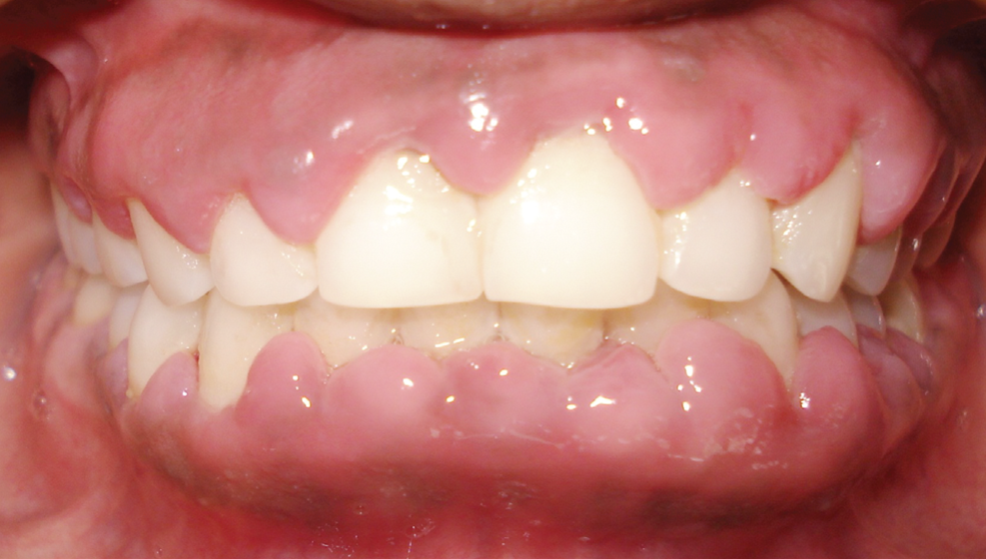

Slide 33
Tumorlike gingival enlargement:
Pregnancy tumor is a benign hyperplastic gingival lesion occurring during pregnancy
  Synonym: Angiogranuloma
  Pregnancy tumor
  Pregnancy epulis

Slide 34
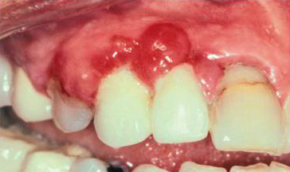

Slide 35
It is not a neoplasm; it is an inflammatory response to bacterial plaque and is modified by the patient’s condition.
It usually appears after the third month of pregnancy but may occur earlier.
Incidence …… 1.8% to 5%.

Slide 36
A discrete mushroom like flattened spherical mass that protrudes from the gingival margin or more commonly from the interproximal space
Attached by a sessile or pedunculated base & tends to expand laterally
Pressure from the tongue and cheek perpetuates its flattened appearance

Slide 37
Generally dusky red or magenta it has a smooth glistening surface that often exhibits numerous deep red pin point markings
It is a superficial lesion and ordinarily does not invade the underlying bone
The consistency varies, the mass is usually semi firm, but it may have various degree of softness and shape friability
It is usually painless

Slide 38
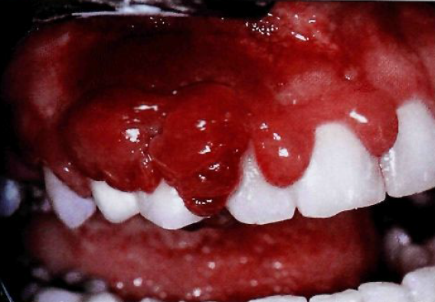
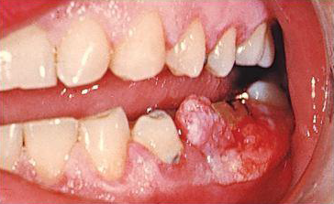

Slide 39
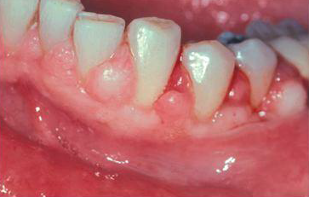
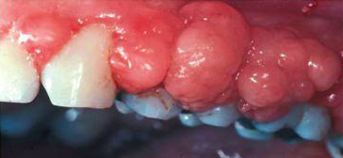

Slide 40
Enlargement in puberty:
Occurs in both male and female adolescents
Appears in areas of plaque accumulation
After puberty the enlargement undergoes spontaneous reduction but does not disappear until plaque and calculus are removed

Slide 41
Clinical features:
The size of the gingival enlargement greatly exceeds that usually seen in association with comparable local factors
Marginal and interdental and is characterized by prominent bulbous interproximal papillae
Often, only the facial gingivae are enlarged, and the lingual surfaces are relatively unaltered

Slide 42
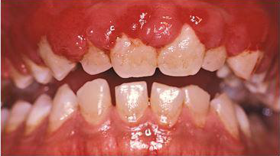

Slide 43
Summary
GE is one of the commonly encountered entity in the clinic & has various implications like niches for infection & esthetic concern
Diagnosis of the exact nature of enlargement & etiologic factor plays a critical role in elimination of exaggerated lesions

Slide 44
REFERENCE
Newman MG, Takei HH, Klokkevold PR, Carranza FA. Carranza’s clinical periodontology, 10th ed. Saunders Elsevier; 2007.
Lindhe J, Lang NP and Karring T. Clinical Periodontology and Implant Dentistry. 6th ed. Oxford (UK): Blackwell Publishing Ltd.; 2015.
Newman MG, Takei HH, Klokkevold PR, Carranza FA. Carranza’s clinical periodontology, 13th ed. Saunders Elsevier; 2018.

Slide 45

THANK YOU

